Slide 1
Quantum Enhanced AFQMC
Zohim Chandani, Davide Vodola

Slide 2
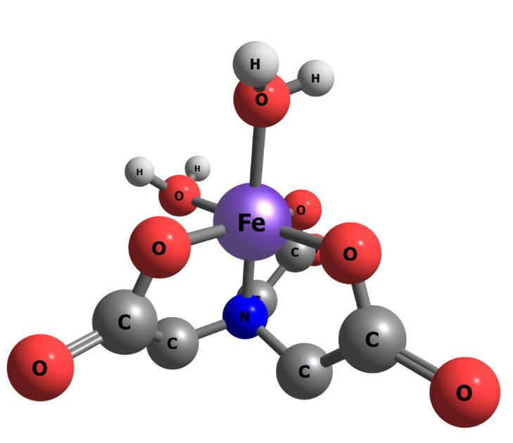
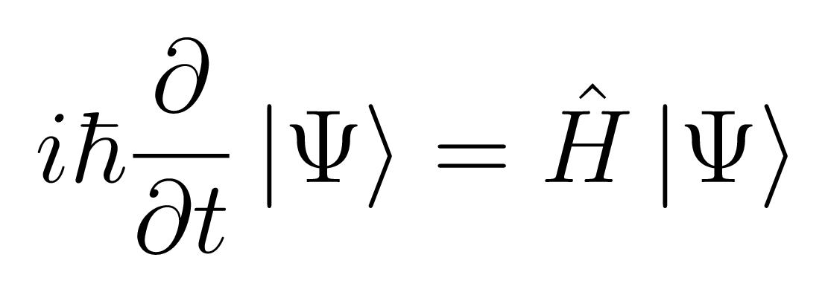
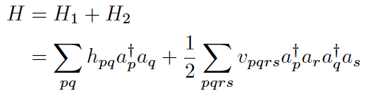
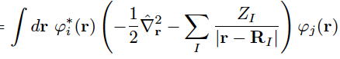
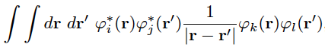
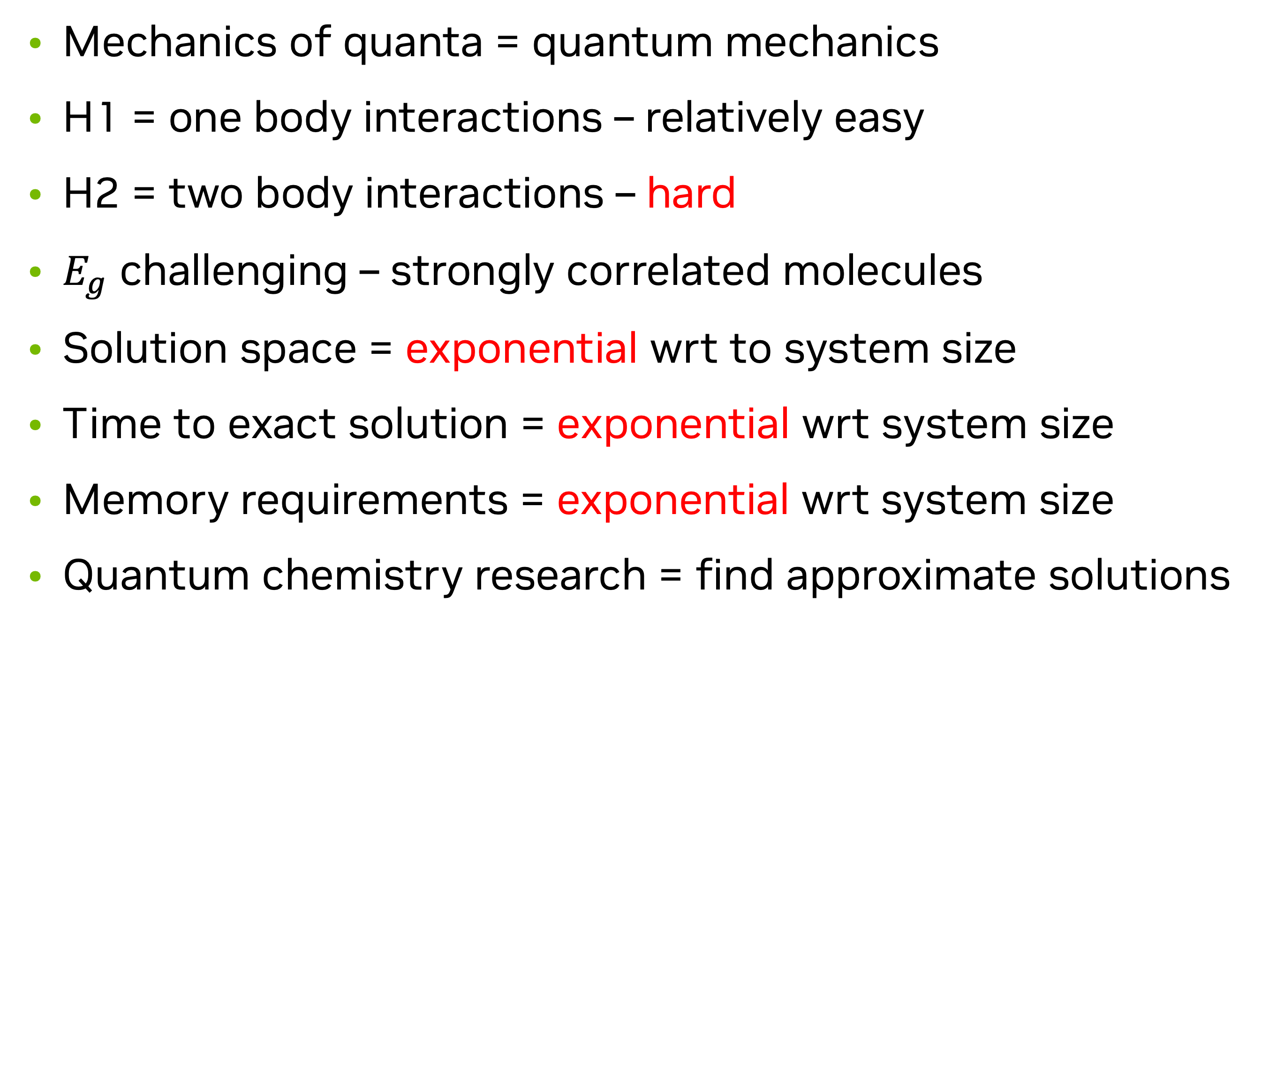
Problem of interest
Mechanics of quanta = quantum mechanics
H1 = one body interactions – relatively easy
H2 = two body interactions – hard
$E_{g}$ challenging – strongly correlated molecules
Solution space = exponential wrt to system size
Time to exact solution = exponential wrt system size
Memory requirements = exponential wrt system size
Quantum chemistry research = find approximate solutions
Notes:
Non relativistic treatement
H has exponentially large dimensions
Fermionic creation and anhillation operators – create and anhillate e in various orbitals
hpq= one body elements – behaviour of individual particles independent of others
Vpqrs = 2 electron replusion integrals – pairwise interactions between particles in the system
E_g – first step in computing properties of molecules
understand molecular stability, reactivity
Reference point for e transition

Slide 3
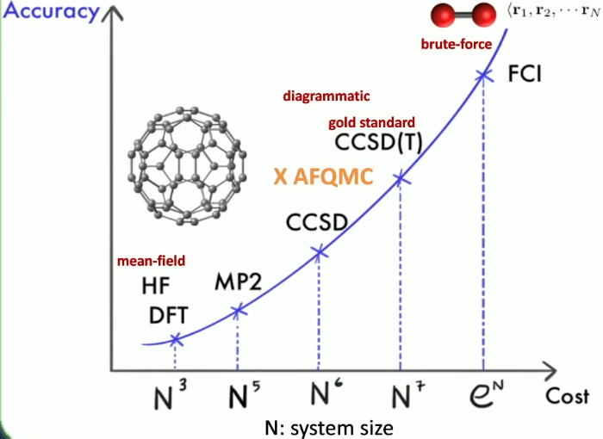
Quantum Chemistry Toolbox
Classical Solutions
Joonho Lee, AFQMC beyond HF, IPAM, 2023
Notes:
Mean filed – cheapest – C60
HF: approximate many e wfn via a single slater det, apply mean field approx (e move in an avg field – simplifies complex e-e interactions)
CCSD is the gold standard
Full CI – brute force exact method – exponential cost – can do o2 with good enough basis set
MP2 perturbation theory – decent accuracy

Slide 4
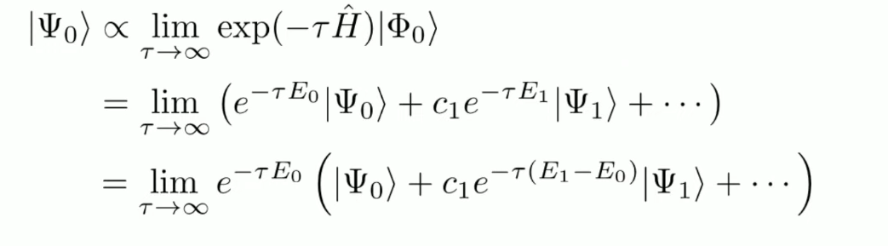
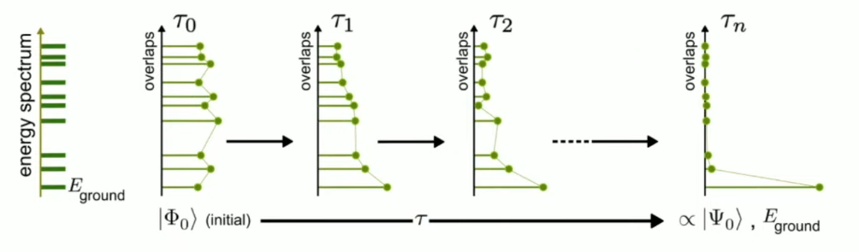
Time Evolution
Joonho Lee, AFQMC beyond HF, IPAM, 2023
Notes:
Task – find Eg
Expand phi0 in the eigenbasis of H = psi0 + psi1…
H Psi = E Psi -
All the other terms are exponentially suppressed
Assumption – phi0 has some overlap with psi0
Long tau limit, we get the exact ground state psi0
Store H and Psi – exponential sclating – not feasible
Solution AFQMC – what if we could stochastically realise this time evolution
Avoid exponential scaling of H and psi
find an efficient way to apply the imaginary time propagator - onto some initial state to time evolve it

Slide 5
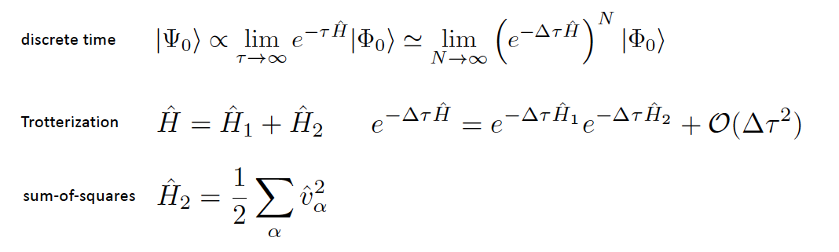
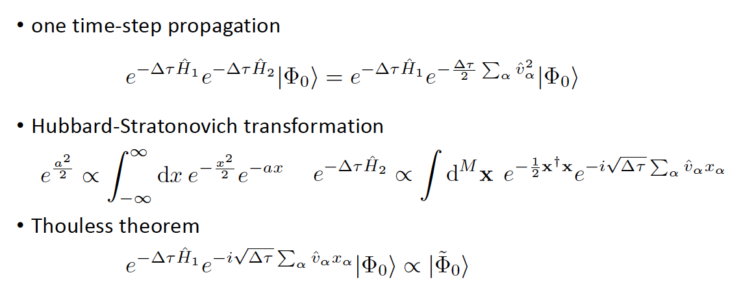
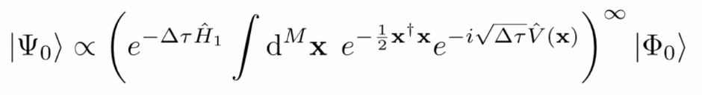
AFQMC
Auxiliary Field Quantum Monte Carlo
Discretize time
Trotterize
Sum the squares
Propagate a timestep
Add the auxillary fields
Thouless theorem
Monte carlo sample the high dimensional integral
Notes:
AFQMC = stochastic realization of ITE
Discrete time – take timesteps to infinity
Torterrization – break up h1 and h2
H2 is 2 body operator – difficult – break it up into sum of squares
Hubbard stratonovich transformation
Valpha^2 - complicated interacting term which we cant do efficiently
Hence we intro a indentity and an integral which leaves us with v
V = linear term = sum of one body fermionic operators
V is like H1 which we can tackle
Overall we replace H2 with terms like H1 – price to pay is you have to do an integral over some real space (auxillary space)
Good news – we removed the exponential – apply one body propagator to a slater determinant yields another SD – efficient to store – cubic scaling wrt size on classical computer
We have to do a high dimensional integral = monte carlo sampling
This is too good to be true
We have phase and sign problems

Slide 6
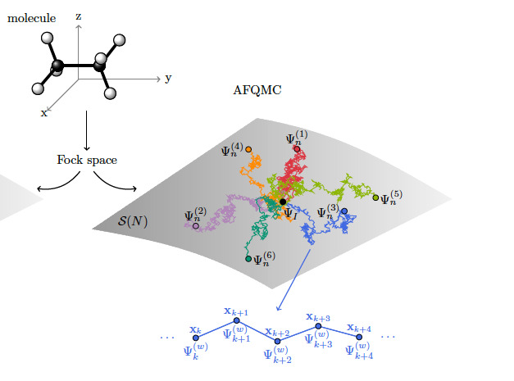
AFQMC
Whole picture
Motta & Zhang, Ab initio computations of molecular systems by AFQMC, 2017
Notes:
Sample various x’s = diff walkers = diff coloured lines
Walker = slater determinant = easy to store, avoids exponential memory scaling compared to statevec
In the end we have a SD with a one body operator in the final integral hence we avoid exponential scaling in the ITE

Slide 7
Quantum Computing
Study quantum systems with quantum systems
Quantity of interest:
Wfn and qubits are law abiding citizens of QM
Exponential memory growth with bits
Linear growth with qubits
Hence the interest of doing computations with psi on quantum computers
Memory requirements
VQE demo on CUDA-Q docs
Notes:
Good to simulate to test if algorithms will work when we have FTQC

Slide 8
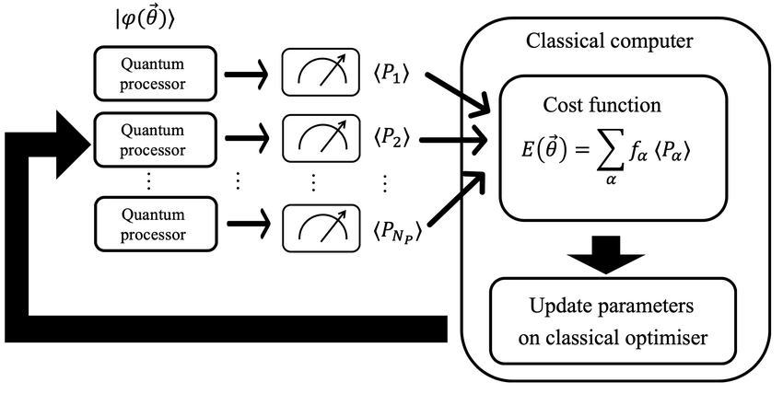
VQE
A short intro
e2e acceleration
BPs
Efficient gradients
Grad vs grad free
Ansatz
Parallelization strategies
Local vs global
Shadows
Error mitigation
Error correction
Endo et al. Hybrid quantum-classical algorithms and quantum error mitigation, 2020.

Slide 9

The whole picture so far
Notes:
Sample various x’s = diff walkers = diff coloured lines
Walker = slater determinant = easy to store, avoids exponential memory scaling compared to statevec
In the end we have a SD with a one body operator in the final integral hence we avoid exponential scaling in the ITE

Slide 10
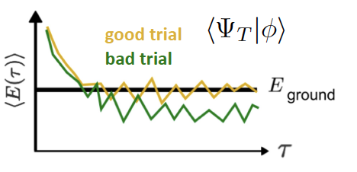
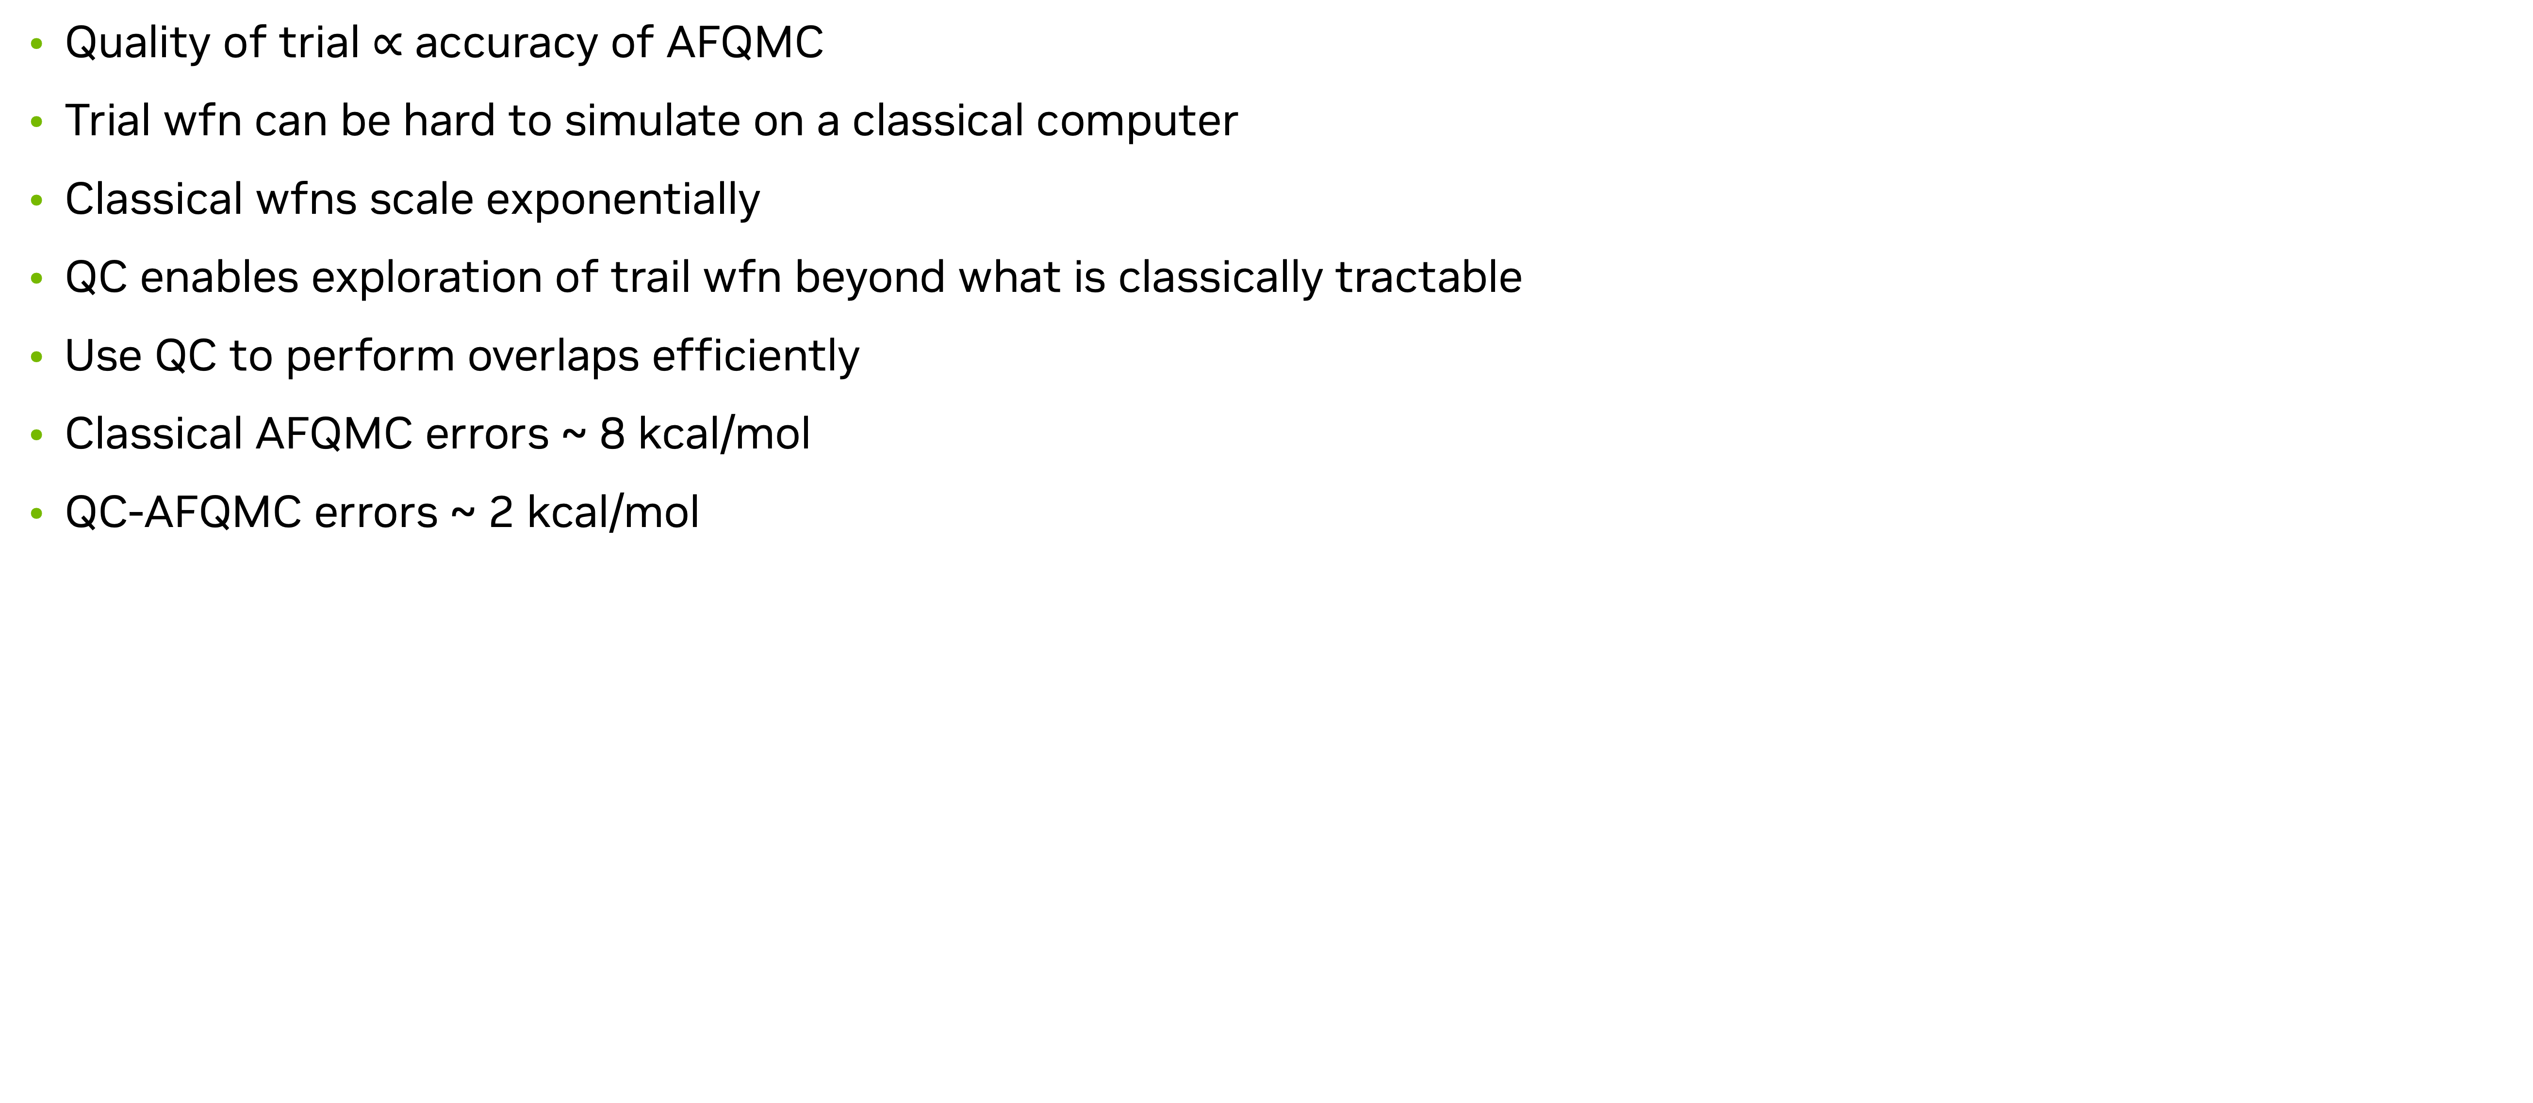
Quantum Enhanced AFQMC
Why?
Quality of trial $∝$ accuracy of AFQMC
Trial wfn can be hard to simulate on a classical computer
Classical wfns scale exponentially
QC enables exploration of trail wfn beyond what is classically tractable
Use QC to perform overlaps efficiently
Classical AFQMC errors ~ 8 kcal/mol
QC-AFQMC errors ~ 2 kcal/mol
Huggins et al. Unbaising fermionic quantum Monte Carlo with a QC, 2021.
Notes:
We wanna calculate <psi | H | phi>
AFQMC = psi and phi are walkers
QE-AFQMC = psi is vqe trail wfn
We care about overlaps of the trial with the walkers, this we can do efficiently on QCs.

Slide 11
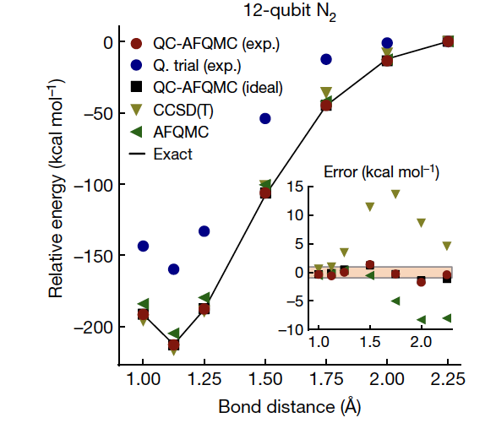
Quantum Enhanced AFQMC
Results
Huggins et al. Unbaising fermionic quantum Monte Carlo with a QC, 2021.

Slide 12
Molecule of interest
BASF
FeNTA: strongly correlated
Chelating agent: bind to metal ions to form stable complexes
Shield undesired influence of ions
Detergents: remove hard water ions and improve cleaning ability
Textiles: remove ions from fabrics to improve dyeing
Mining: form stable complexes with ions to improve extraction/ purification
Agriculture: supply plants with low concentrations of ions for health growth
BASF – leading international producer of chelating agents

Slide 13
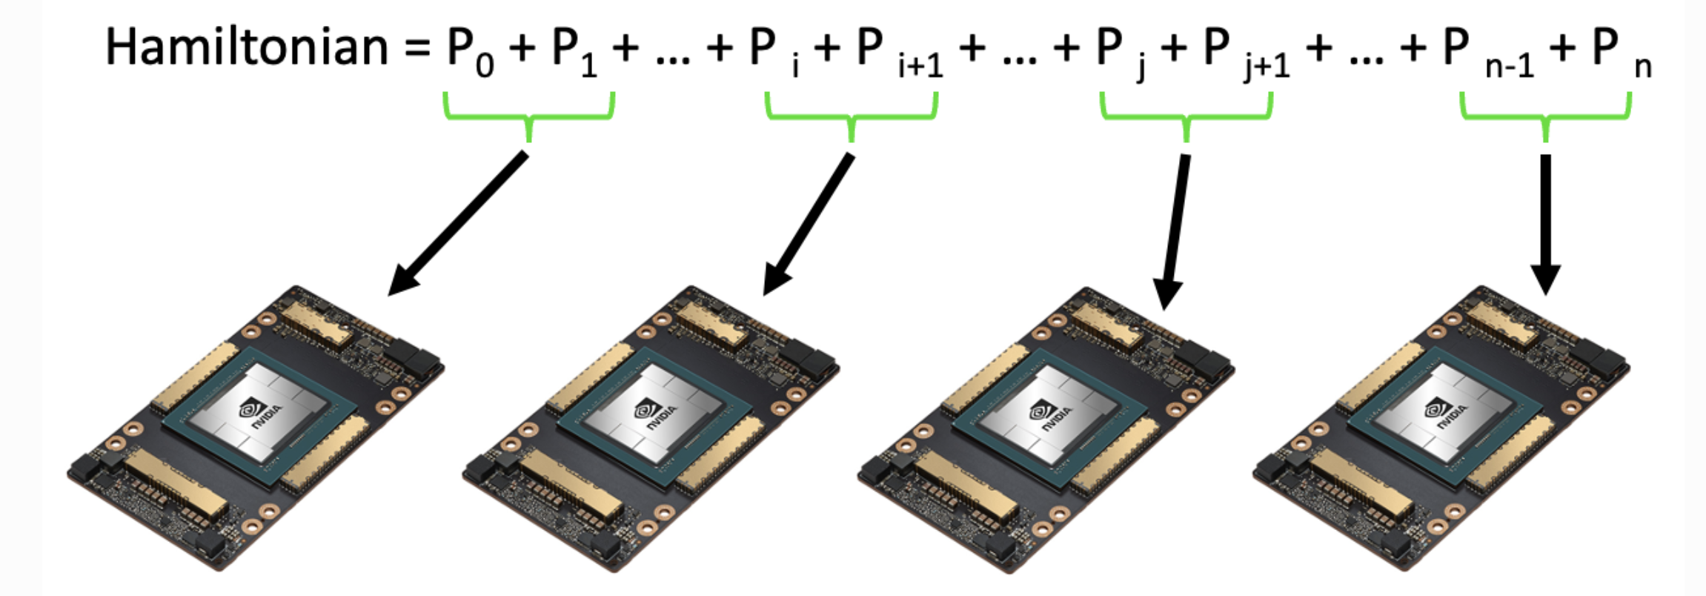
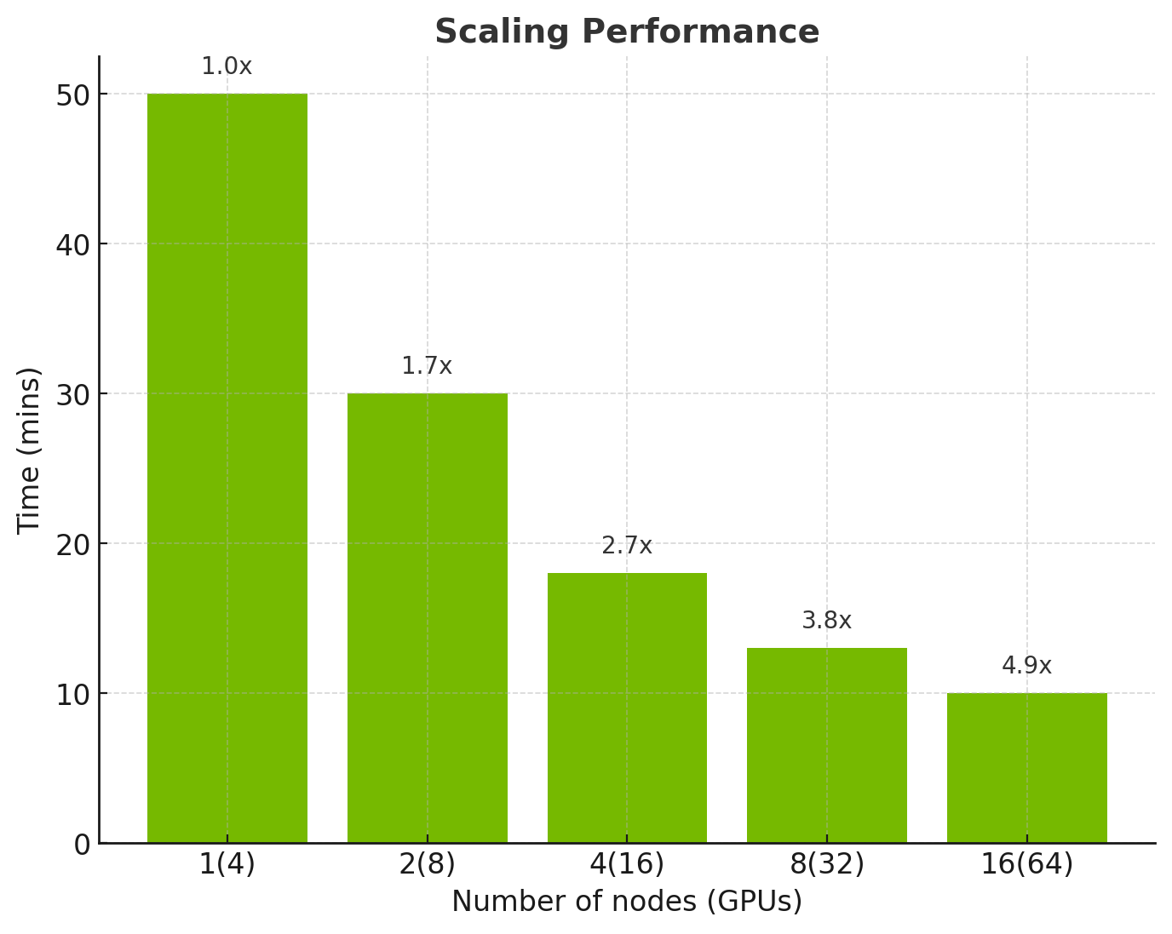
Quantum Enhanced AFQMC with CUDA-Q
24q, 3 layers, 4000 NM epochs
H = 30,000 terms
QNP ansatz – relatively low depth
QNP ansatz – generated states have physical meaning (preserve spin, number of particles)
Hyperparameters: optimizers, layers
Sto-3g basis set
Notes:
Ie they preserve spin, and number of particles

Slide 14
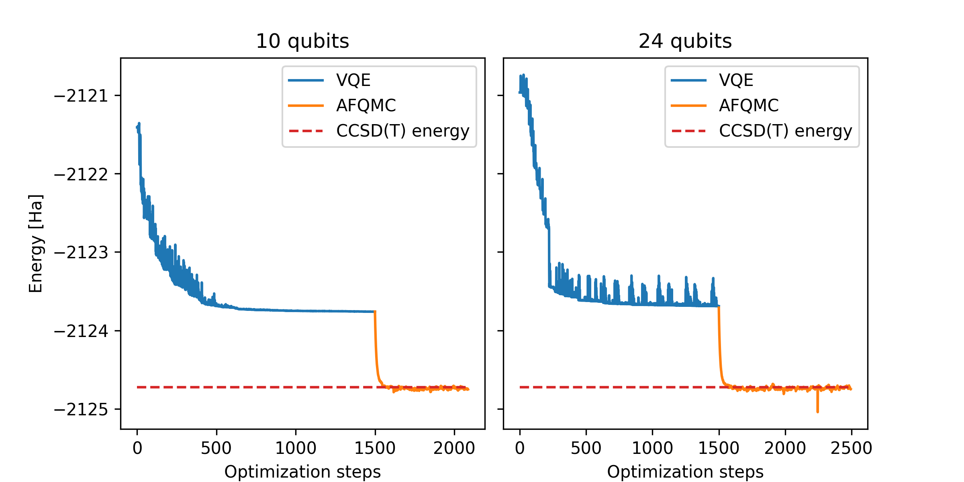
Results
Notes:
Sto3g basis set – minimal
N_active orbitals = means the rest are frozen and you work within an active space
You then build a H that only acts on the active orbitals
Wanna ideally do chemistry on outermost e since they take part in reactions
Chckpoint rohf – mean field approx. of H – pyscf takes a molecule and creates a mean field that these atoms live in
chkptfile_cas – contains info on the active space
Hydrogen – 1s, 2s, 2p – infinite states
Less states you have in basis – less presice your wfn
Sto3g has less basis elements compared to ccpvtz

Slide 15

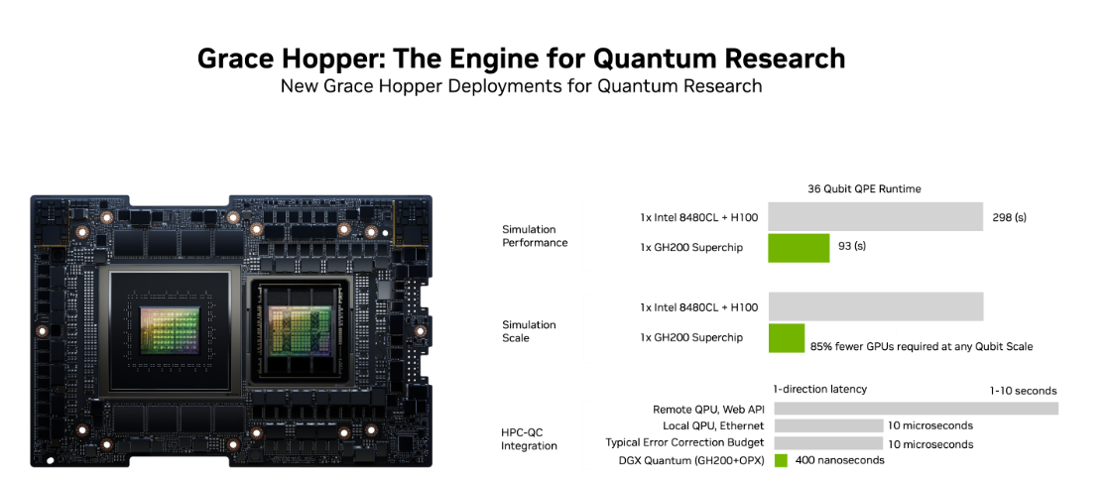
Forward thinking
GPU optimizers to minimize data transfer
GPU accelerated AFQMC – end to end accelerated
Memory issues for number of walkers
Grace + Hopper memory pooling
Scale to 60q with MPS
H with 1m terms which describes the problem more accurately

Slide 17
Misc
shifter --image=nersc/sc_cuda_quantum:24.10
$ pip install cupy-cuda11x
Cudaq-Perlmutter repo: https://github.com/zohimchandani/cudaq-perlmutter

